Slide 1
Some reflections on a possible holographic description of time chapter in progress for my forthcoming book “The Emergence of spacetime In string theory” (Pickering&Chatto, Editor Dean Rickles)
Tiziana Vistarini
University of Illinois at Chicago

Slide 2
Research program started between 2001-2006 .
They have been trying to apply the idea of holography in a string theoretical setting different from that of the AdS/CFT correspondence, in which time would arise holographically from a timeless setting.
This research program has not yet been taken to completion as there have been – and still there are - many challenges and technical difficulties. Also it branches off in different ways to attack the problem, all of them trying to imitate the reasoning that led to the AdS/CFT duality.
Although still incomplete the program, if completed, would:
involve a more realistic bulk geometry, de Sitter spacetime. Our universe seems to have a small positive cosmological constant. Also it is considered to have an asymptotic de Sitter structure in the future.
deliver an account of how some physics with time arises from some timeless physics generally considered a case of supervenience.

Slide 3

Few basic things about AdS/CFT:
A feature of the black entropy law is its universal applicability. Several attempts of understanding the microscopic origin of this law produced a variety of ideas culminating in the AdS/CFT correspondence, involving a conformal field theory over a Minkowski boundary and a quantum gravity theory in anti-de-Sitter space time . The prototypical example involves a Type IIB string theory on S^5 × AdS_5.
Two crucial features of this correspondence are:
Boundary data of CFT holographically reconstruct the radial dimension of the bulk.
Boundary data of CFT holographically reconstruct the compact extra dimensions S^5 of the bulk.

Slide 4
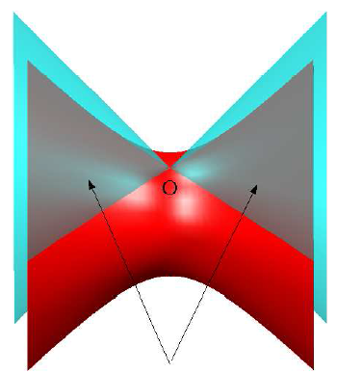
Anti De Sitter spacetime. It has a boundary at spacelike infinity. The boundary is Minkowski spacetime.
The feature of the AdS/CFT duality mimicked in this new theoretical setting is the holographic way in which some boundary data encode the radial evolution of bulk scalar fields. Precisely, the RG flow of the boundary field theory – i.e. the beta functions describing the change of the coupling with respect to the change of the energy scale – matches with the radial evolution of the field’s potential propagating in the bulk.
Picture from Moschella (2005)

Slide 5
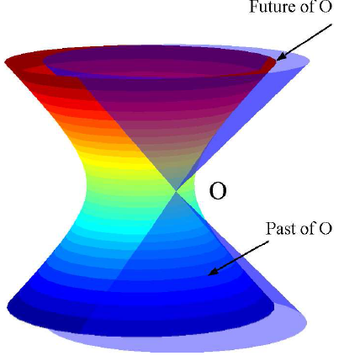
Trying to get an emergent time requires involving theories with asymptotic structures different from those of the AdS/CFT. The bulk spacetime involved in this context is De Sitter. Such spacetime has a boundary at timelike infinity.
Broadly speaking, it has been thought that if a theory of quantum gravity exists in a de Sitter, then its hypothetical dual would be a timeless quantum field theory, i.e. a quantum field theory on a spacelike boundary.
Figure from Moschella (2005)
PROBLEM: Trying to embed de Sitter spacetime as a solution of string theory did not produce so far satisfactory results. The absence of concrete string compactifications of de Sitter makes hard formulating and testing a dS/CFT conjecture in the string context.

Slide 6
A first attempt of conjecturing a dS/CFT correspondence is made by Strominger (2001) - along with Balasubramanian, Boer and Mimic (2002) - in a way that in principle did not require string theory inputs.
Now, a hypothetical correspondence that aims to mimic the AdS/CFT duality should satisfy at least the following requirements:
(1) symmetries of the dual theories must match.
(2) It should exist a dictionary for translating correlation functions
Point (2) is basically also the source for developing considerations about the holographic nature of the bulk radius in the AdS/CFT since it is the variation of the boundary field coupling (with respect to the change of energy scale) that encodes the radial behavior of the bulk field.

Slide 7
If my reading is correct
about (a) Strominger explicitly compute the asymptotic symmetric group of the de Sitter, i.e. is the Euclidean conformal group in D dimensions (for example SO(D,1) if you think to the de Sitter as a hyperboloid embedded in flat spacetime of signature (1,D)).
The asympotic group gives information about the fact that if a quantum gravity theory in a de Sitter exists, then its hypothetical dual would be a local quantum conformal field theory on the Euclidean boundary at time t=±∞
About (b) the trace of the stress boundary tensor, which has a natural relation with the RG flow, gives information about how the bulk spacetime reacts to changes of the boundary metric. In particular a precise relation between dilatations over the boundary and time translation in the bulk is obtained.The correspondence can be read in both directions.
Still this is a conjectured holographic correspondence. It tells you how a string theory in the de Sitter, if it exists, may look like

Slide 8
A second way to attack the problem of embedding the conjectured dS/CFT in the context of string theory is developed by Strominger and Gutperle (2003) and it uses D-branes and S-branes.
Basically, they argue that string theory may produce the kind of Euclidean field theory needed by the conjectured correspondence. They discuss gravity solutions produced by some specific case. One of them is the D=4 Einstein-Maxwell gravity corresponding to a charged S0-brane.
Let’s briefly sketch how the line of reasoning goes:
D-p branes are D-branes in p+1 dimensions.
S-p branes are thought to be the spacelike version of ordinary D branes. They have p+1 dimensions, all of them are spatial.
It is argued that string theory contains them as result of decay of unstable D-branes, which are branes with a tachyon field whose potential resembles a double well. S-branes are in this sense time-like kink solitonic solution.
In particular, an S-2 brane is a time-like kink solution of an unstable D-3 brane.
The Euclidean field theory involved in the dS/CFT seems to be naturally related to these spacelike branes. Understanding what time-like kink solution means here clarify in what sense they are spacelike solutions of string theory. And this is a crucial tool for grounding the conjectured correspondence in the context of string theory.

Slide 9
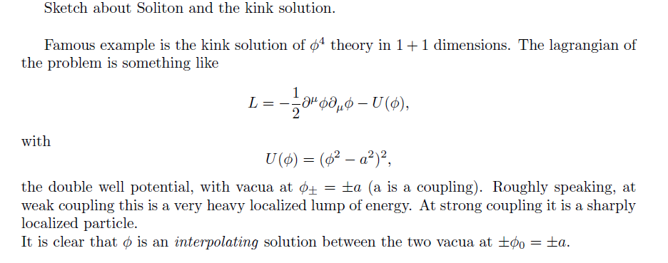

Slide 10


Slide 11
Back to the conjectured ds/CFT.
In the AdS/CFT correspondence the D-brane field theory holographically encodes a spatial dimension (the bulk’s radius).
Since string theory produces the CFT side of the conjecture ds/CFT, namely the S-brane field theory, the authors, by using an analogy with the AdS/CFT, argue that the S-brane field theory holographically reconstructs a time dimension.
Some gravity solutions computed by the authors:
D=4 Einstein-Maxwell gravity corresponding to a charged S0 brane
The bosonic action of D=11 supergravity theory corresponding to an S-5 brane field theory

Slide 12
Would the ds/CFT conjecture, if proved, be a case of supervenienience? Time dependent physics supervening timeless physics? What about this hypothetical supervenience ground the idea of an emergent time?
What do I mean with supervenience?
I think that the only notion of supervenience compatible with emergence (in a weak sense) is the one originally introduced in the debate about philosophy of mind:
properties A supervene properties B just in case there cannot be an A difference without a B-difference, and not viceversa.
The dS/CFT conjectured duality and the AdS/CFT duality both do not satisfy this definition, being both one-to-one maps. For example, in the case of the ds/CFT time dependent physics supervenes timeless physics and viceversa.
This is of course a second way of talking about supervenience (as argued by many) but I I claim that it is not compatible with emergence, even in its weakest form.

Slide 13
Said that, my claims are:
In the AdS/CFT the bulk radius supervenes lower dimensional dynamics. Space supervening space (see also Rickles 2012). This case of supervenience (that can be read in both directions) does not ground an idea of emergence (even in its weakest form)
In the dS/CFT time supervenes timeless dynamics by mimicking the same logic underlying the appearance of the radius in the AdS/CFT. Although supervenience can be also read in both directions here, I claim that this case differs from the previous one in so far as it seems to allow the reintroduction of a weak form of emergence, here applied to time. Time supervening timeless structure. The fact that time is not present in the timeless CFT brings in a weak notion of asymmetry, hence genuine novelty.

