Slide 1
Quantum Gravity at Low Energies
David Wallace
Departments of HPS and Philosophy, University of Pittsburgh
Morzine Summer School, 27th June 2022

Slide 2
What is quantum gravity?

Slide 3
What is quantum gravity?
Common definitions:
Any physical theory which combines general relativity and quantum theory

Slide 4
What is quantum gravity?
Common definitions:
Any physical theory which combines general relativity and quantum theory
Any physical theory that has classical general relativity and quantum theory as limiting cases or partial approximations

Slide 5
Claims about a quantum theory of gravity

Slide 6
Claims about a quantum theory of gravity
We don’t have one!
  Specifically, we don’t have an acceptable theory of quantum gravity in the sense that we have an acceptable quantum theory of the strong/weak/electromagnetic interactions
Empirically, we don’t need one!
  Specifically –outside exotica like Hawking radiation, black hole interiors, pre-inflationary cosmology – all known empirical phenomena are describable within either classical General Relativity or the Standard Model of Particle Physics

Slide 7
Claims about a quantum theory of gravity
We don’t have one!
  Specifically, we don’t have an acceptable theory of quantum gravity in the sense that we have an acceptable quantum theory of the strong/weak/electromagnetic interactions
Empirically, we don’t need one!
  Specifically –outside exotica like Hawking radiation, black hole interiors, pre-inflationary cosmology – all known empirical phenomena are describable within either classical General Relativity or the Standard Model of Particle Physics

Slide 8
Claims about a quantum theory of gravity
We don’t have one!
  Specifically, we don’t have an acceptable theory of quantum gravity in the sense that we have an acceptable quantum theory of the strong/weak/electromagnetic interactions
Empirically, we don’t need one!
  Specifically –outside exotica like Hawking radiation, black hole interiors, pre-inflationary cosmology – all known empirical phenomena are describable within either classical General Relativity or the Standard Model of Particle Physics

Slide 9
(Better) claims about a quantum theory of gravity

Slide 10
(Better) claims about a quantum theory of gravity
We have an acceptable quantum theory of gravity in almost exactly the sense that we have an acceptable quantum theory of the strong / weak / electromagnetic interactions
  It’s just the quantum field theory that we get if we apply modern QFT methods to general relativity
  It requires a high-energy cutoff, imposed by new physics, to be well-defined – but so does the Standard Model!
We have an abundance of observational evidence supporting (at least large parts of) that theory

Slide 11
(Better) claims about a quantum theory of gravity
We have an acceptable quantum theory of gravity in almost exactly the sense that we have an acceptable quantum theory of the strong / weak / electromagnetic interactions
  It’s just the quantum field theory that we get if we apply modern QFT methods to general relativity
  It requires a high-energy cutoff, imposed by new physics, to be well-defined – but so does the Standard Model!
We have an abundance of observational evidence supporting (at least large parts of) that theory

Slide 12
(Better) claims about a quantum theory of gravity
We have an acceptable quantum theory of gravity in almost exactly the sense that we have an acceptable quantum theory of the strong / weak / electromagnetic interactions
  It’s just the quantum field theory that we get if we apply modern QFT methods to general relativity
  It requires a high-energy cutoff, imposed by new physics, to be well-defined – but so does the Standard Model!
We have an abundance of observational evidence supporting (at least large parts of) that theory

Slide 13
(Better) claims about a quantum theory of gravity
We have an acceptable quantum theory of gravity in almost exactly the sense that we have an acceptable quantum theory of the strong / weak / electromagnetic interactions
  It’s just the quantum field theory that we get if we apply modern QFT methods to general relativity
  It requires a high-energy cutoff, imposed by new physics, to be well-defined – but so does the Standard Model!
We have an abundance of observational evidence supporting (at least large parts of) that theory

Slide 14
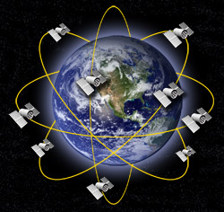

Slide 15
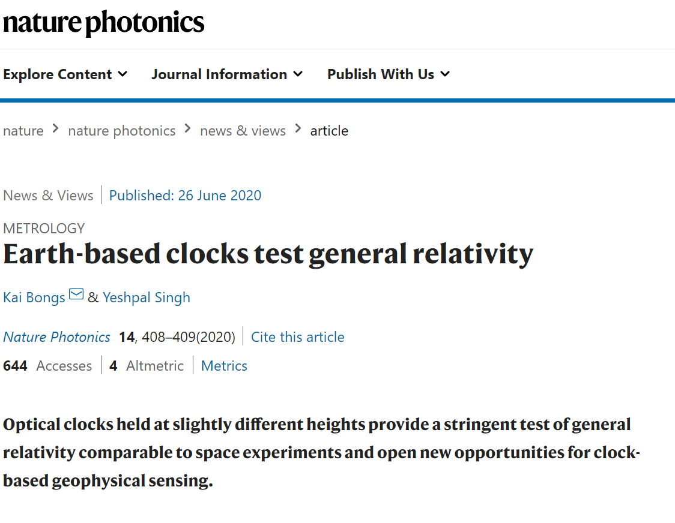
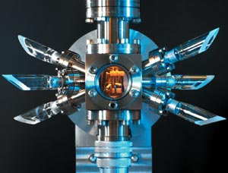

Slide 16
Tests of QM on a gravitational background
Dropping rocks!
GPS
Atomic/optical clock tests of time dilation

Slide 17
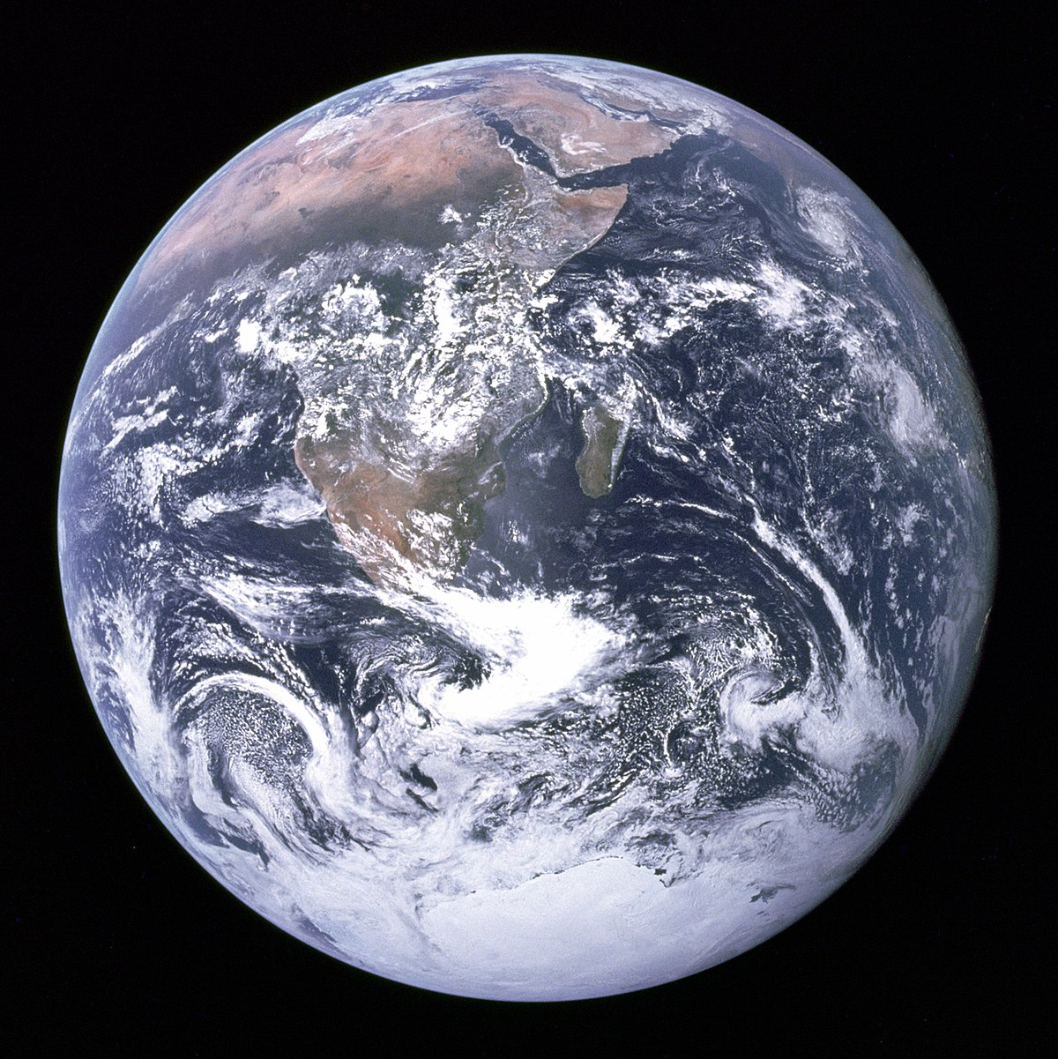

Slide 18
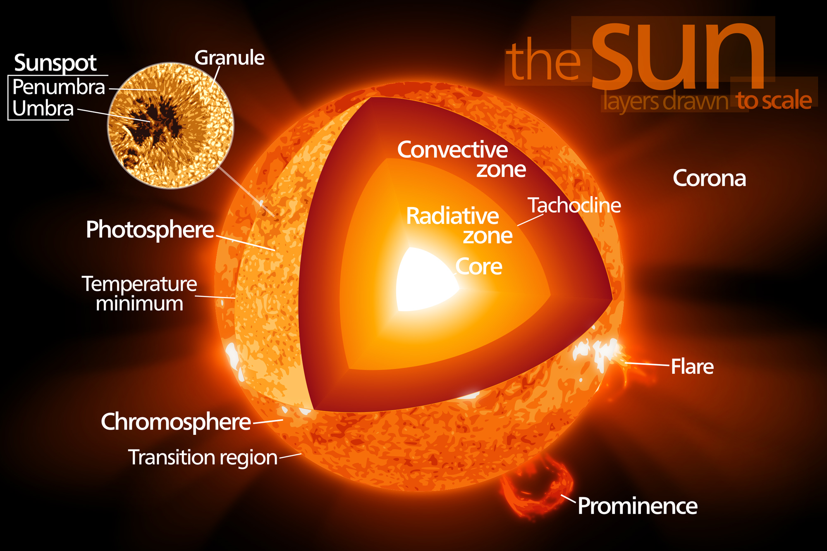

Slide 19
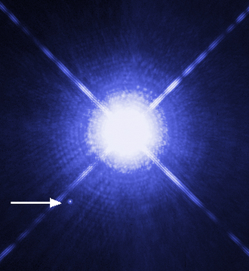
Sirius B

Slide 20
Quantum matter with Newtonian self-gravity
Planets (solid/liquid equations of state require QM)
Stars (nuclear fusion requires QM)
White dwarfs (degeneracy pressure is irreducibly quantum)

Slide 21
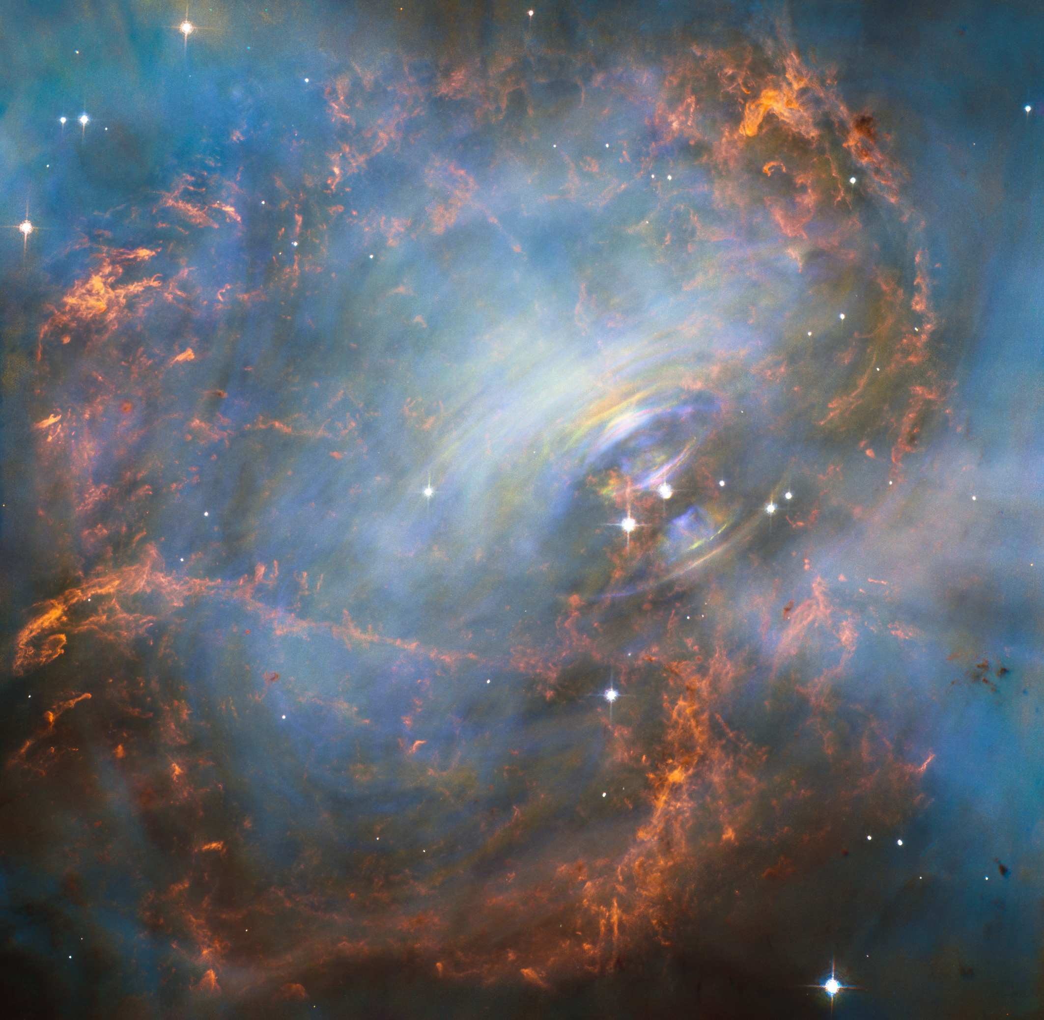
(The Crab Nebula)

Slide 22
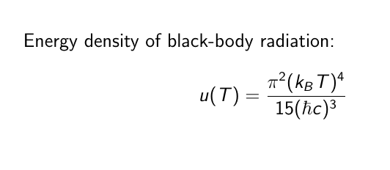

Slide 23
Quantum matter with general-relativistic self-gravity
Neutron stars (relativistic gravity + neutron degeneracy pressure)
Supermassive stars / supernovae (black-body radiation)
Cosmology (black-body radiation)

Slide 24
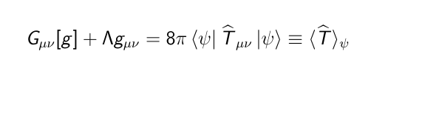
Semiclassical Gravity
plus QFT on the background defined by g

Slide 25
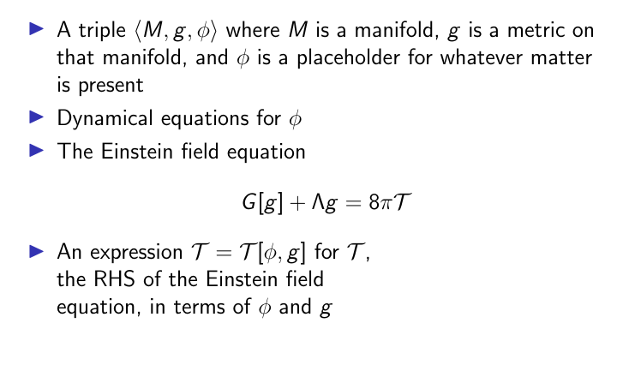
Models of General relativity

Slide 26
Applications of general relativity

Slide 27
Applications of general relativity
Vacuum GR (no matter, T=0)
Phenomenological GR (matter treated phenomenologically, e.g. dust, compact planets)
Classical GR (matter treated as fields satisfying action principle, stress-energy tensor defined by action, e.g. Einstein-Maxwell or Einstein-Klein-Gordon)
Semiclassical GR (matter treated as a quantum field, T is expected value of action-defined stress-energy tensor)

Slide 28
Applications of general relativity
Vacuum GR (no matter, T=0)
Phenomenological GR (matter treated phenomenologically, e.g. dust, compact planets)
Classical GR (matter treated as fields satisfying action principle, stress-energy tensor defined by action, e.g. Einstein-Maxwell or Einstein-Klein-Gordon)
Semiclassical GR (matter treated as a quantum field, T is expected value of action-defined stress-energy tensor)

Slide 29
Applications of general relativity
Vacuum GR (no matter, T=0)
Phenomenological GR (matter treated phenomenologically, e.g. dust, compact planets)
Classical GR (matter treated as fields satisfying action principle, stress-energy tensor defined by action, e.g. Einstein-Maxwell or Einstein-Klein-Gordon)
Semiclassical GR (matter treated as a quantum field, T is expected value of action-defined stress-energy tensor)

Slide 30
Applications of general relativity
Vacuum GR (no matter, T=0)
Phenomenological GR (matter treated phenomenologically, e.g. dust, compact planets)
Classical GR (matter treated as fields satisfying action principle, stress-energy tensor defined by action, e.g. Einstein-Maxwell or Einstein-Klein-Gordon)
Semiclassical GR (matter treated as a quantum field, T is expected value of action-defined stress-energy tensor)

Slide 31
Applications of vacuum GR
Gravity waves
Black holes

Slide 32
Applications of phenomenological GR
Solar-system physics
Aspects of astrophysics and cosmology

Slide 33
Applications of semiclassical GR
The rest of astrophysics and cosmology

Slide 34
Applications of classical GR
…

Slide 35
Limitations of semiclassical gravity
All these applications are to situations in which quantum fluctuations in stress-energy are very small
(Same as with other semiclassical methods)
What about situations where gravitational fluctuations are large, i.e. superpositions of different stress-energy distributions?

Slide 36
The Page-Geilker experiment
(Don N. Page and C. D. Geilker, Phys. Rev. Lett. 47, 979 – Published 5 October 1981)
Place a large mass in one of two locations, depending on a quantum-mechanically random process
Measure its gravitational field

Slide 37
The Page-Geilker experiment
(Don N. Page and C. D. Geilker, Phys. Rev. Lett. 47, 979 – Published 5 October 1981)
Place a large mass in one of two locations, depending on a quantum-mechanically random process
Measure its gravitational field
50%

Slide 38
The Page-Geilker experiment
(Don N. Page and C. D. Geilker, Phys. Rev. Lett. 47, 979 – Published 5 October 1981)
Place a large mass in one of two locations, depending on a quantum-mechanically random process
Measure its gravitational field
50%

Slide 39
The Page-Geilker experiment
(Don N. Page and C. D. Geilker, Phys. Rev. Lett. 47, 979 – Published 5 October 1981)
Place a large mass in one of two locations, depending on a quantum-mechanically random process
Measure its gravitational field

Slide 40
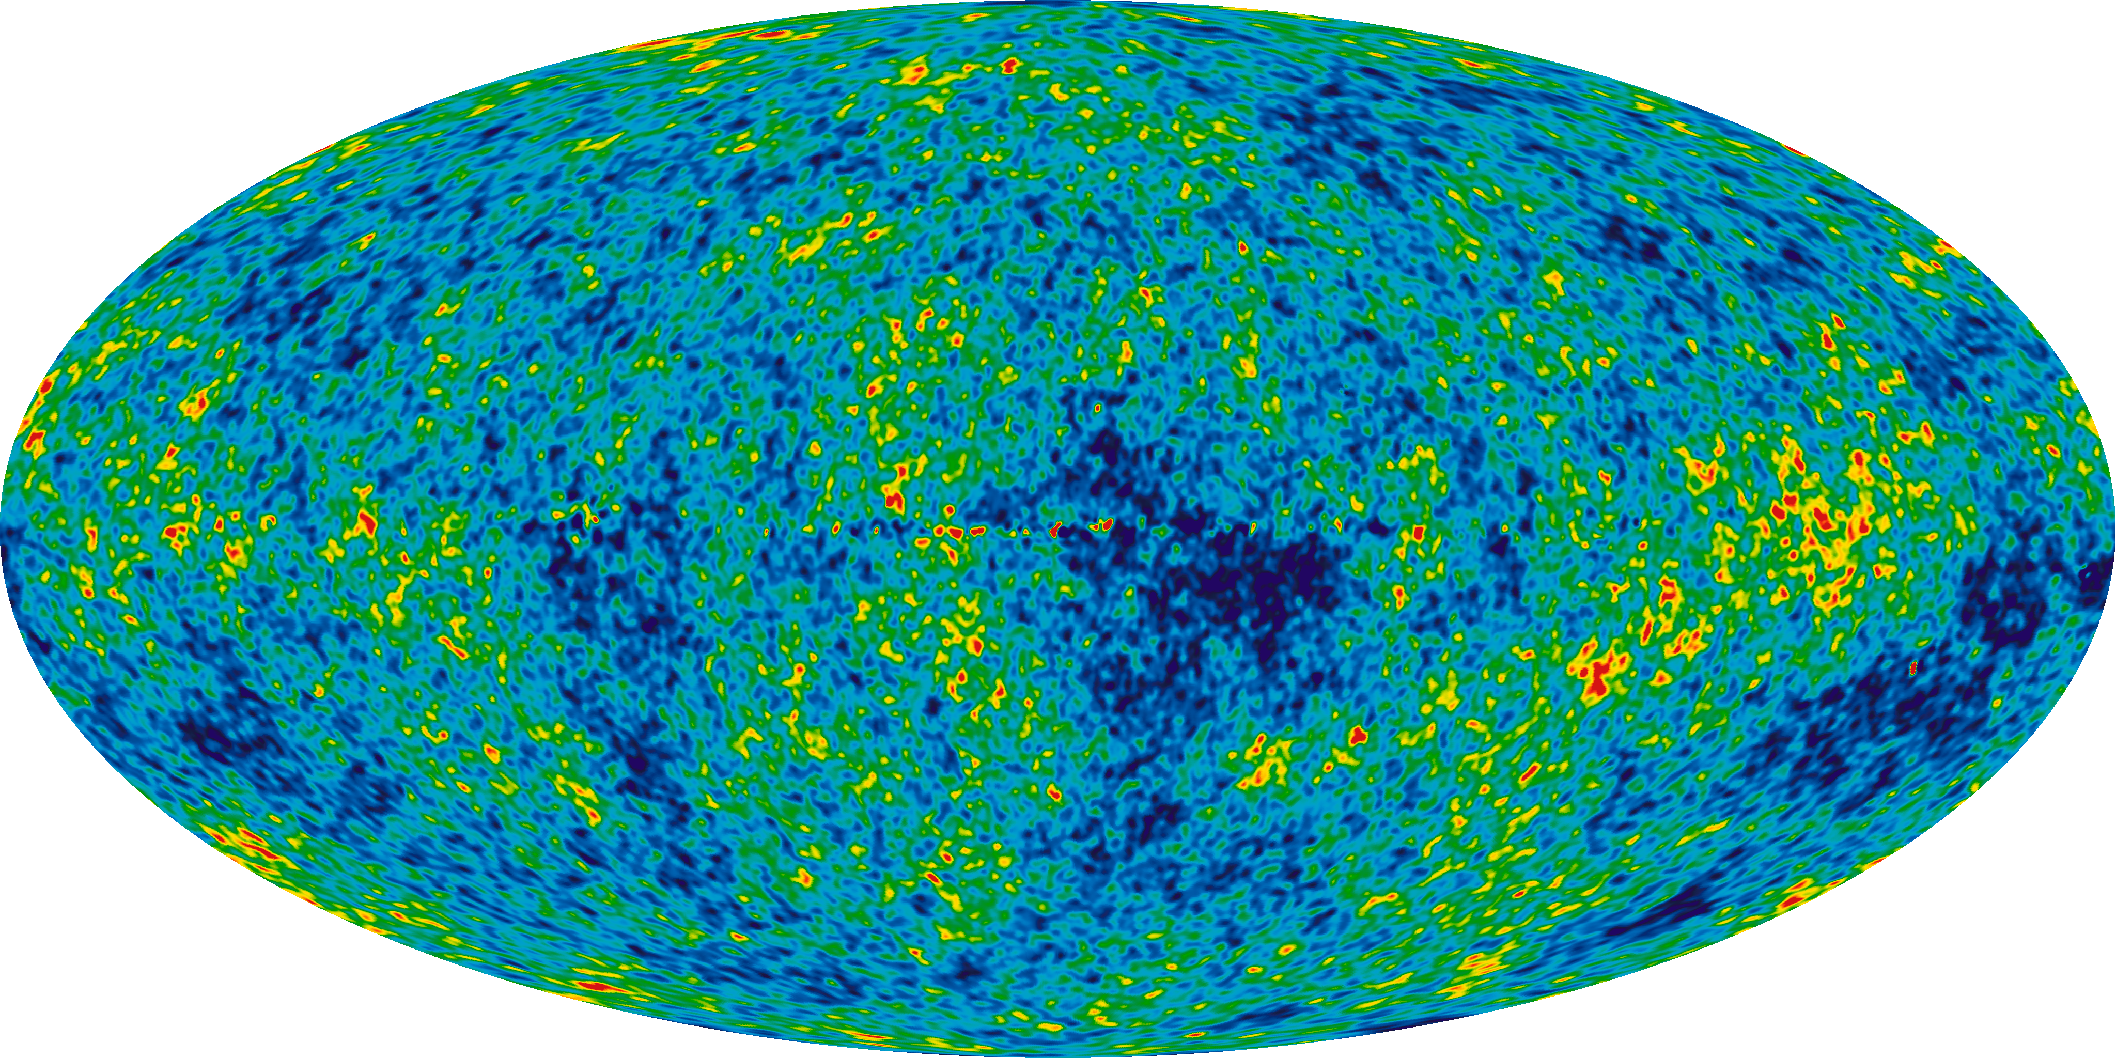

Slide 41
Quantizing metric fluctuations
Split the metric into fixed and fluctuating part:
g = g₀ + h
Quantize h as a quantum field on the background g₀

Slide 42
Quantizing metric fluctuations
Split the metric into fixed and fluctuating part:
g = g₀ + h
Quantize h as a quantum field on the background g₀
Problems:
How is g₀ selected?

Slide 43
Quantizing metric fluctuations
Split the metric into fixed and fluctuating part:
g = g₀ + h
Quantize h as a quantum field on the background g₀
Problems:
How is g₀ selected?
Violates background-independence of GR

Slide 44
Quantizing metric fluctuations
Split the metric into fixed and fluctuating part:
g = g₀ + h
Quantize h as a quantum field on the background g₀
Problems:
How is g₀ selected?
Violates background-independence of GR
Where did semiclassical gravity go?

Slide 45
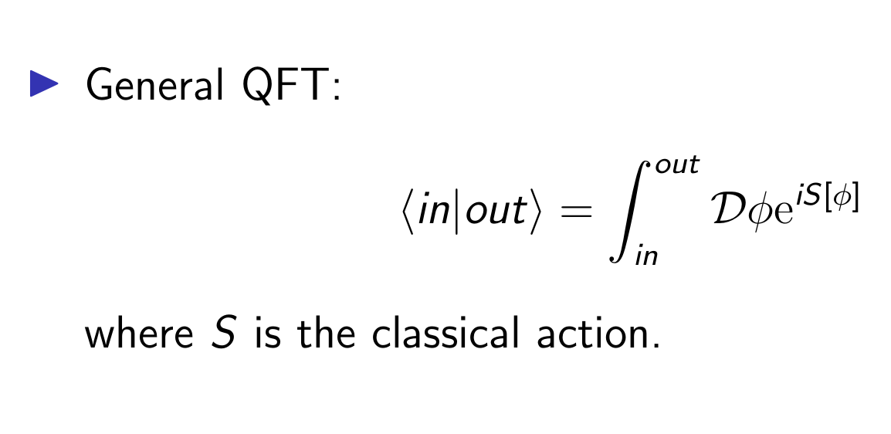
QFT via path integrals

Slide 46
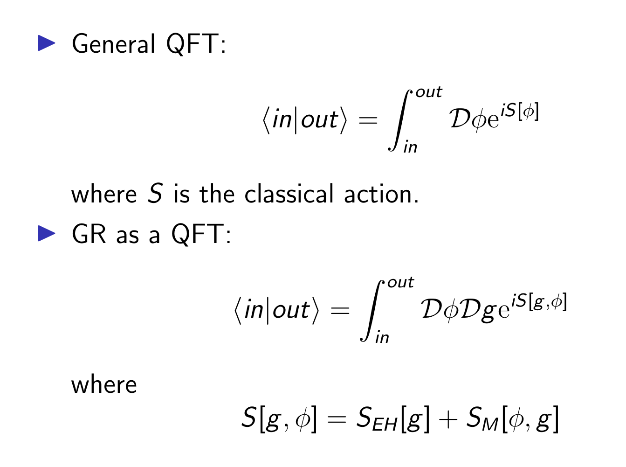
QFT via path integrals

Slide 47
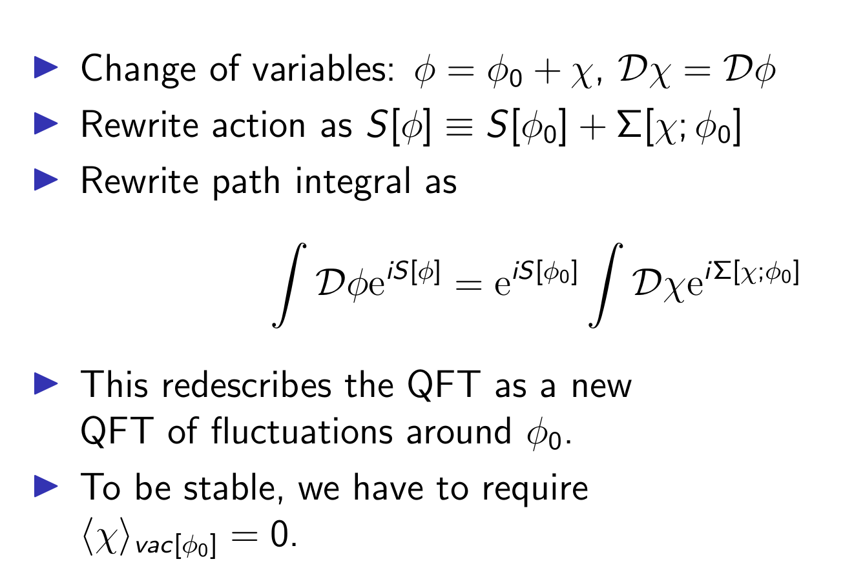
Background field method (rough heuristic version) - I

Slide 48
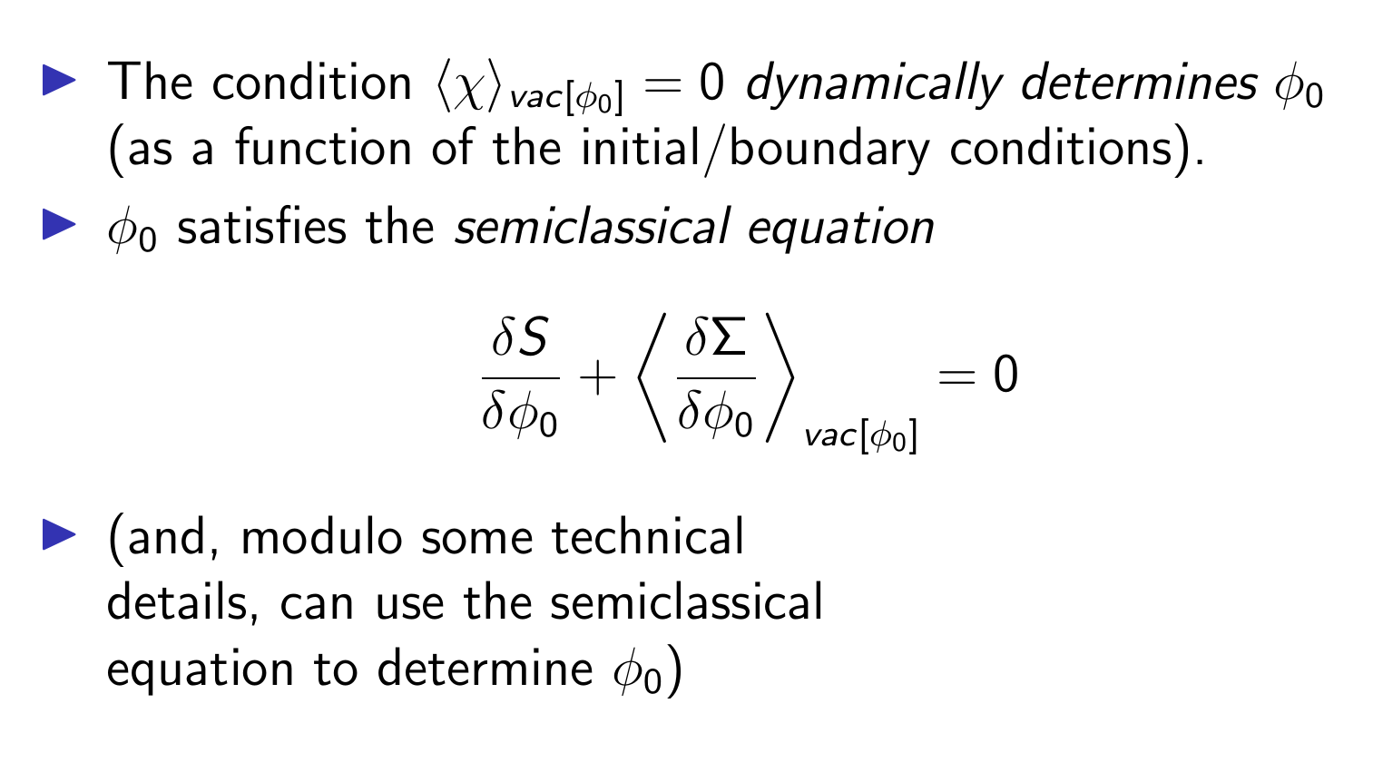
Background field method (rough heuristic version) - II

Slide 49
Applying the background field method to LEQG
The semiclassical equation determines the ground state of an effective QFT
Hence, the background is determined dynamically as part of finding solutions to the GR QFT – not imposed as part of the definition
Excited states of that QFT describe matter excitations and gravitons

Slide 50
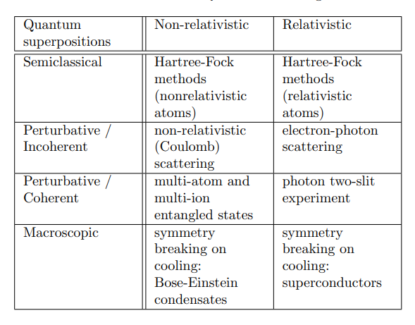
Evidence for QED

Slide 51
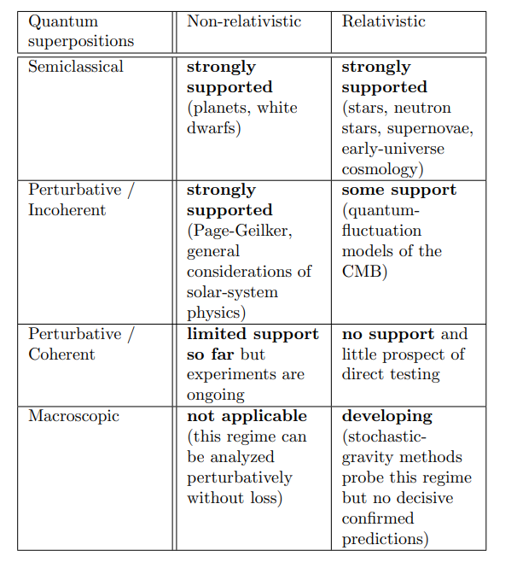
Evidence for LEQG

Slide 52
Limitations of LEQG

Slide 53
Limitations of LEQG
Limitations of the background-field method:
  Macroscopic superpositions, e.g. black holes in different locations (non-equilibrium QFT methods can go beyond the background-field method here)
  (??)fine-grained stat mech of evaporating black holes

Slide 54
Limitations of LEQG
Limitations of the background-field method:
  Macroscopic superpositions, e.g. black holes in different locations (non-equilibrium QFT methods can go beyond the background-field method here)
  (??)fine-grained stat mech of evaporating black holes
Limitations of LEQG itself
  Ultraviolet physics: black hole interior, pre-inflationary physics

Slide 55
The Cosmological Constant Problem (general form)

Slide 56
The Cosmological Constant Problem (general form)
There are very large energy densities associated with the quantum vacuum, due to
  Zero-point fluctuations
  Spontaneous symmetry breaking (Chiral/Higgs condensates)
These energy densities couple to gravity and manifest as a very large value of the observed cosmological constant (many orders of magnitude above what is actually observed)
Empirical adequacy can be saved only by fine-tuning the ‘bare’cosmological constant to a very precise (and very large) value

Slide 57
The Cosmological Constant Problem (general form)
There are very large energy densities associated with the quantum vacuum, due to
  Zero-point fluctuations
  Spontaneous symmetry breaking (Chiral/Higgs condensates)
These energy densities couple to gravity and manifest as a very large value of the observed cosmological constant (many orders of magnitude above what is actually observed)
Empirical adequacy can be saved only by fine-tuning the ‘bare’cosmological constant to a very precise (and very large) value

Slide 58
The Cosmological Constant Problem (general form)
There are very large energy densities associated with the quantum vacuum, due to
  Zero-point fluctuations
  Spontaneous symmetry breaking (Chiral/Higgs condensates)
These energy densities couple to gravity and manifest as a very large value of the observed cosmological constant (many orders of magnitude above what is actually observed)
Empirical adequacy can be saved only by fine-tuning the ‘bare’cosmological constant to a very precise (and very large) value

Slide 59
The Cosmological Constant Problem (in the philosophy literature)
(e.g., Saunders, Schneider, Koberinski)

Slide 60
The Cosmological Constant Problem (in the philosophy literature)
(e.g., Saunders, Schneider, Koberinski)
Need to establish:

Slide 61
The Cosmological Constant Problem (in the philosophy literature)
(e.g., Saunders, Schneider, Koberinski)
Need to establish:
  That vacuum energy is real

Slide 62
The Cosmological Constant Problem (in the philosophy literature)
(e.g., Saunders, Schneider, Koberinski)
Need to establish:
  That vacuum energy is real
  That calculations of vacuum energy in QFT can be trusted

Slide 63
The Cosmological Constant Problem (in the philosophy literature)
(e.g., Saunders, Schneider, Koberinski)
Need to establish:
  That vacuum energy is real
  That calculations of vacuum energy in QFT can be trusted
  That vacuum energy couples to gravity

Slide 64
The Cosmological Constant Problem (in the philosophy literature)
(e.g., Saunders, Schneider, Koberinski)
Need to establish:
  That vacuum energy is real
  That calculations of vacuum energy in QFT can be trusted
  That vacuum energy couples to gravity
All these steps are questionable and/or require speculation about new physics

Slide 65
The Cosmological Constant Problem (from LEQG)

Slide 66
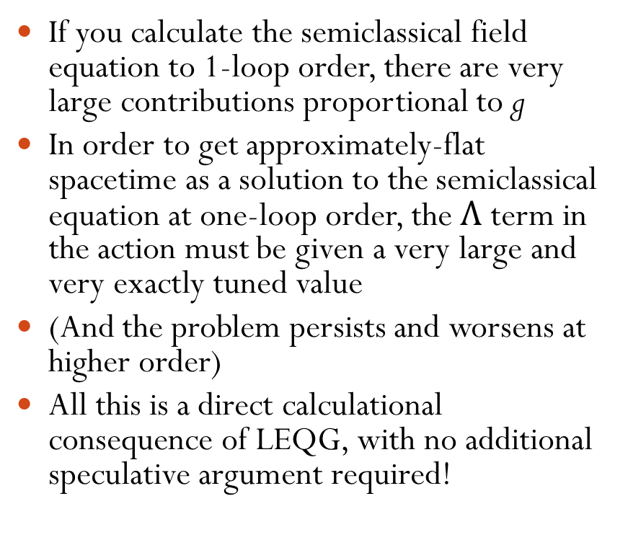
The Cosmological Constant Problem (from LEQG)
If you calculate the semiclassical field equation to 1-loop order, there are very large contributions proportional to g
In order to get approximately-flat spacetime as a solution to the semiclassical equation at one-loop order, the $Λ$ term in the action must be given a very large and very exactly tuned value
(And the problem persists and worsens at higher order)
All this is a direct calculational consequence of LEQG, with no additional speculative argument required!

Slide 67
The Cosmological Constant Problem (from LEQG)
If you calculate the semiclassical field equation to 1-loop order, there are very large contributions proportional to g
In order to get approximately-flat spacetime as a solution to the semiclassical equation at one-loop order, the $Λ$ term in the action must be given a very large and very exactly tuned value
(And the problem persists and worsens at higher order)
All this is a direct calculational consequence of LEQG, with no additional speculative argument required!

Slide 68
The Cosmological Constant Problem (from LEQG)
If you calculate the semiclassical field equation to 1-loop order, there are very large contributions proportional to g
In order to get approximately-flat spacetime as a solution to the semiclassical equation at one-loop order, the $Λ$ term in the action must be given a very large and very exactly tuned value
(And the problem persists and worsens at higher order)
All this is a direct calculational consequence of LEQG, with no additional speculative argument required!

Slide 69
The Cosmological Constant Problem (from LEQG)
If you calculate the semiclassical field equation to 1-loop order, there are very large contributions proportional to g
In order to get approximately-flat spacetime as a solution to the semiclassical equation at one-loop order, the $Λ$ term in the action must be given a very large and very exactly tuned value
(And the problem persists and worsens at higher order)
All this is a direct calculational consequence of LEQG, with no additional speculative argument required!

Slide 70
Conclusions

Slide 71
Conclusions
General relativity, treated as a QFT, is a (fairly) well-behaved effective field theory
Semiclassical gravity, and the theory of quantum metric fluctuations around a fixed background, are (fairly) well-behaved special cases of LEQG
There is a lot of evidence for the semiclassical regime of LEQG, and at least some evidence for the fluctuation regime
The cosmological constant problem is an anomaly (a la Kuhn) in LEQG
If we reject LEQG, the case for the cosmological constant being a problem gets a lot weaker, but the cost is high

Slide 72
Conclusions
General relativity, treated as a QFT, is a (fairly) well-behaved effective field theory
Semiclassical gravity, and the theory of quantum metric fluctuations around a fixed background, are (fairly) well-behaved special cases of LEQG
There is a lot of evidence for the semiclassical regime of LEQG, and at least some evidence for the fluctuation regime
The cosmological constant problem is an anomaly (a la Kuhn) in LEQG
If we reject LEQG, the case for the cosmological constant being a problem gets a lot weaker, but the cost is high

Slide 73
Conclusions
General relativity, treated as a QFT, is a (fairly) well-behaved effective field theory
Semiclassical gravity, and the theory of quantum metric fluctuations around a fixed background, are (fairly) well-behaved special cases of LEQG
There is a lot of evidence for the semiclassical regime of LEQG, and at least some evidence for the fluctuation regime
The cosmological constant problem is an anomaly (a la Kuhn) in LEQG
If we reject LEQG, the case for the cosmological constant being a problem gets a lot weaker, but the cost is high

Slide 74
Conclusions
General relativity, treated as a QFT, is a (fairly) well-behaved effective field theory
Semiclassical gravity, and the theory of quantum metric fluctuations around a fixed background, are (fairly) well-behaved special cases of LEQG
There is a lot of evidence for the semiclassical regime of LEQG, and at least some evidence for the fluctuation regime
The cosmological constant problem is an anomaly (a la Kuhn) in LEQG
If we reject LEQG, the case for the cosmological constant being a problem gets a lot weaker, but the cost is high

Slide 75
Conclusions
General relativity, treated as a QFT, is a (fairly) well-behaved effective field theory
Semiclassical gravity, and the theory of quantum metric fluctuations around a fixed background, are (fairly) well-behaved special cases of LEQG
There is a lot of evidence for the semiclassical regime of LEQG, and at least some evidence for the fluctuation regime
The cosmological constant problem is an anomaly (a la Kuhn) in LEQG
If we reject LEQG, the case for the cosmological constant being a problem gets a lot weaker, but the cost is high

Slide 76
Subsidiary material (not for main talk)

Slide 77
Mattingly on Page-Geilker
“only a peculiar reading of quantum mechanics [Everett’s!-DW] is incompatible with Page and Geilker’s result. It is certainly interesting that some versions of some interpretations are incompatible with semiclassical gravity. But it is only interesting…
… I have no solution to the measurement problem… Yet I cannot worry overmuch about a proposal for a gravitation theory merely because it fails to solve the problem, or rather because it undermines one or two of the proposed solutions.”
(Mattingly, “Is quantum gravity necessary?” (Einstein Studies v.11, 2005)

Slide 78
Interpretations of QM that permit a unitary description of Page-Geilker
Everett
Other versions of decoherent/consistent histories
Copenhagen
QBist
Pragmatist
Dirac / von Neumann (Wigner’s friend)
De Broglie-Bohm
Modal
(not: Dynamical-collapse)

Slide 79
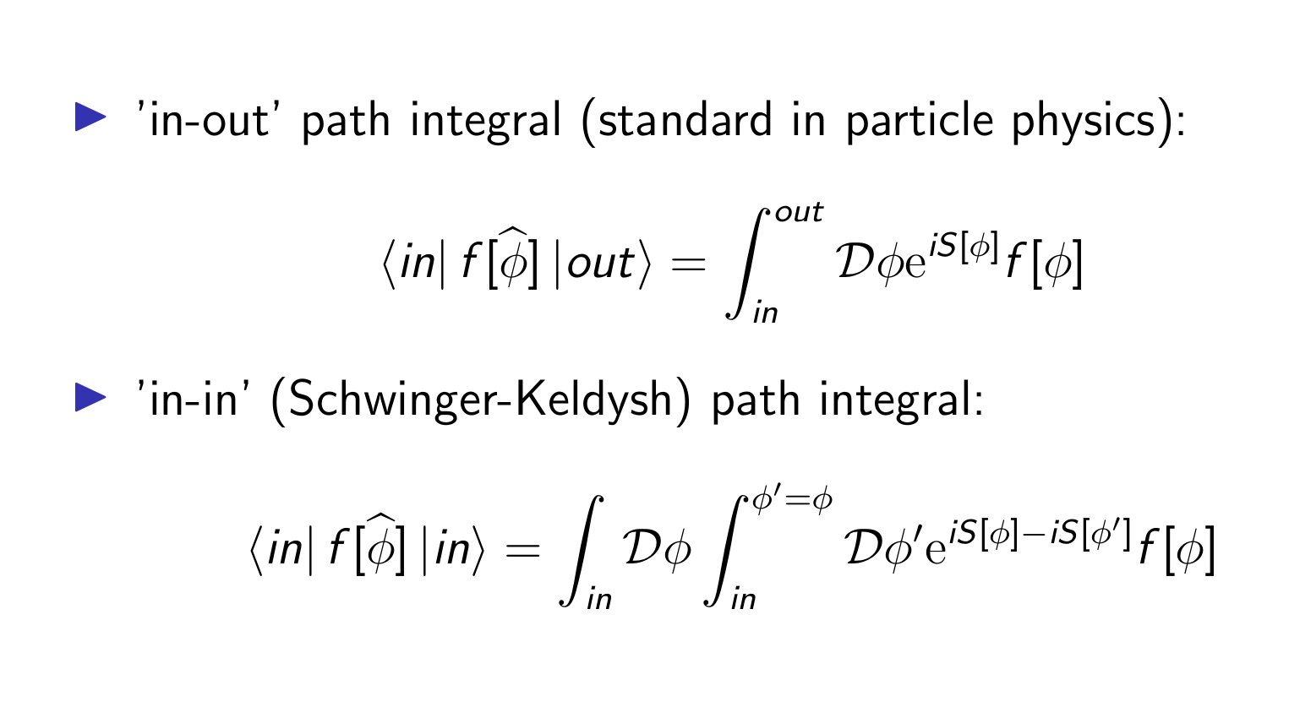
The Schwinger-Keldysh path integral

